Slide 1


Slide 2
Abstract
Sportsense is designed to enhance the overall sports event experience by addressing the current gap in information about local sports events. Many details regarding these events are currently unavailable to the public. The primary goal of Sportsense is to fill this void by providing information about lesser-known local sports to a wider audience. Additionally, Sportsense offers a platform for people to stay informed about a diverse range of sports competitions. Users can access information and news related to various sports through the application, creating a comprehensive platform for sports enthusiasts to connect with a wide range of sporting events.
The application is structured around three interlinked modules: Admin, Local match management, and Users. The Admin module functions as the central control hub of the system. Local Match Management Module handles all matters related to local sports. Information about all local and non-local sports and more is available to the user through this application.

Slide 3
Modules
In this topic we have 3 modules:
ADMIN
USER
LOCAL MATCH MANAGEMENT

Slide 4
1.Admin
Purpose: Manage and update sports event data, venue information, and user accounts.
Features:
Admin login
Post sports details
Manage sports details
Post sports news
Manage sports news
User account management
Manage Local match management
Manage Local match details and facilities

Slide 5
2.User
Purpose: Offer sports enthusiasts a personalized experience.
Features:
Register
Login
View Live sports details
View sports details
View sports news
View local match details and facility
View facilities
View notifications of local match
User profiles

Slide 6
3.Local match management
Purpose: Enable event organizers to provide information about their games.
Features:
Register
Login
Post local match details and facilities
Manage local match details and facilities
Post notification of local match

Slide 7
Software specification
One of the most difficult tasks is selecting software, once the system requirement is find out then we have to determine whether a particular software package fits for those system requirements. This section summarizes the application requirement.
Frontend: Flutter (Dart),html,CSS
Backend: Django (Python)
Database: MySQL
Notification: Push notifications using Firebase Cloud Messaging or similar services.

Slide 8
Existing and Proposal system
While many sports-based applications focus exclusively on international sports, Sportsense stands out by prioritizing regional sports, aiming to deliver comprehensive information about local sports to the public. One standout feature is the introduction of the Local Match Management module, dedicated to promoting local sports competitions. This innovative approach bridges the gap between sports enthusiasts and the vibrant world of local rivalries, enhancing the visibility and excitement surrounding athletic events.

Slide 9
Advantages
Local Sports Focus
Information about local sports
Enhanced Visibility of local sports
Real-time sports details
Personalised User Profiles
User-friendly Interface
Notifications
Secure Authentication

Slide 10
Future scope
Tickets can be booked through the application
Live Streaming
Community Engagement
Integration with Social Media
etc

Slide 11
Conclusion
Sportsense fills a crucial void by prioritizing local sports, addressing the lack of information about regional events. Unlike many applications focusing only on international sports, Sportsense stands out for its commitment to delivering comprehensive details about local sports. This innovative approach not only enhances visibility but also bridges the gap between enthusiasts and the dynamic world of local rivalries.

Slide 12
Data flow diagrams

Slide 13
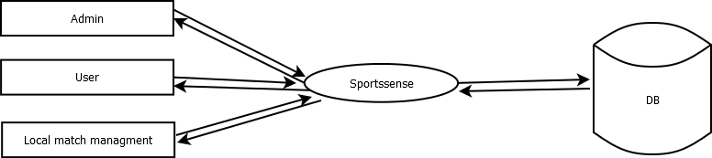
Level 1

Slide 14
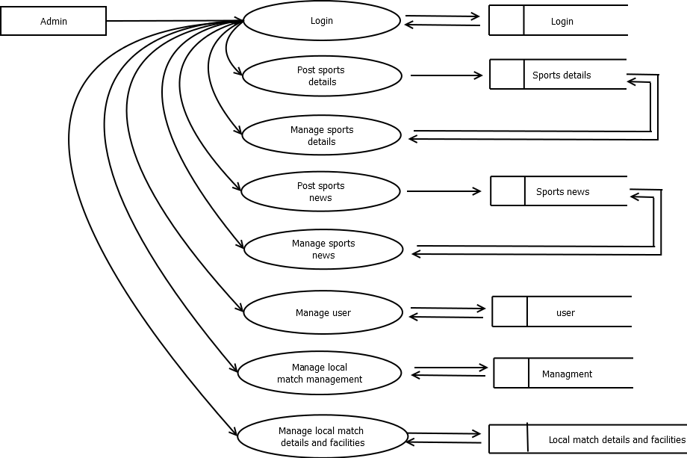
Level 1.1

Slide 15
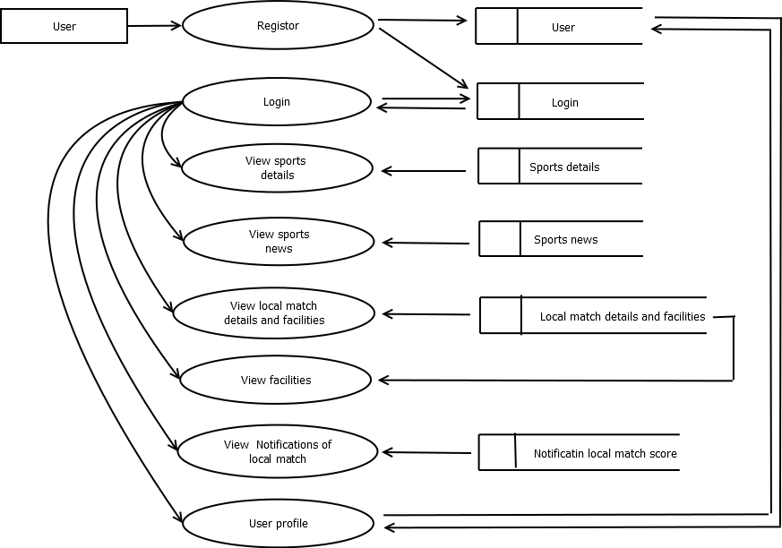
Level 1.2

Slide 16
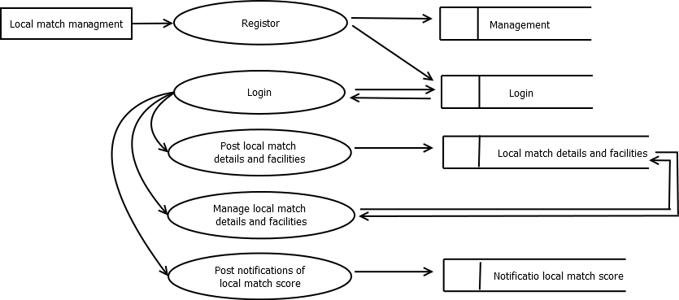
Level 1.3

Slide 17
Use case diagram

Slide 18
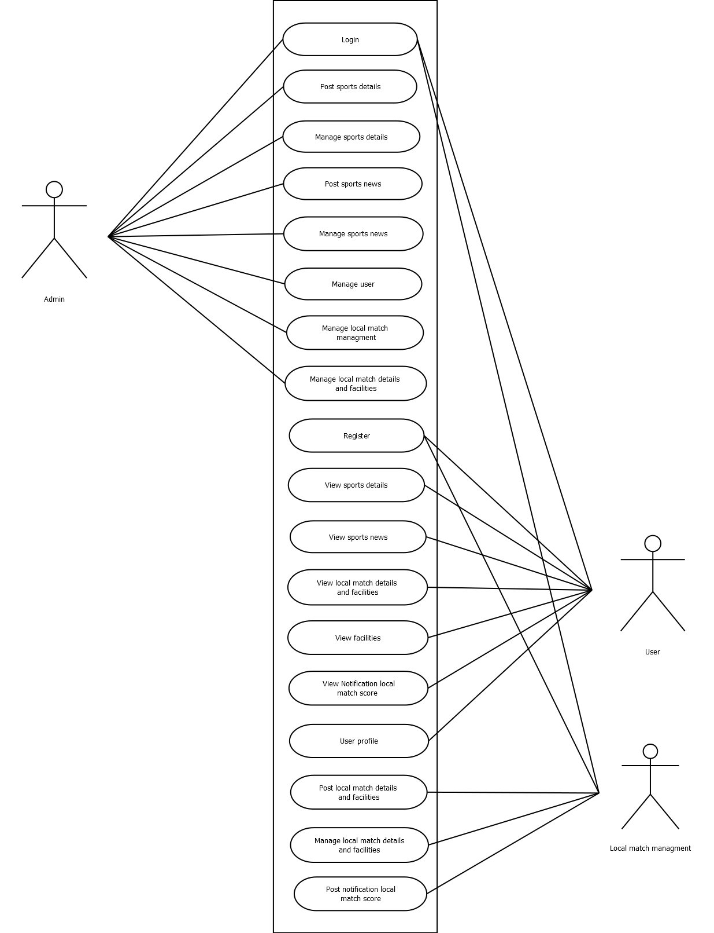

Slide 19
ER diagram

Slide 20
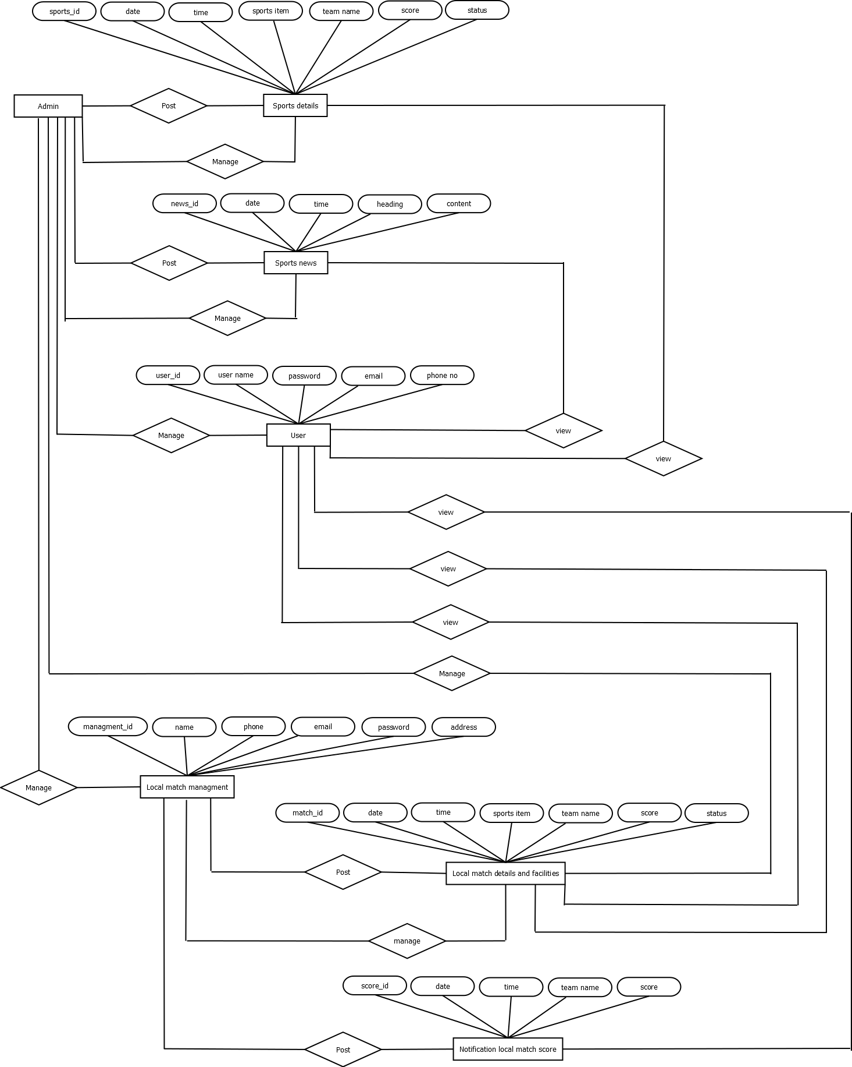

Slide 21
Tables

Slide 22
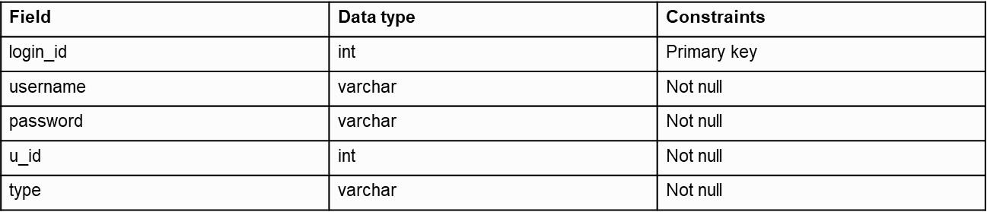
Login

Slide 23
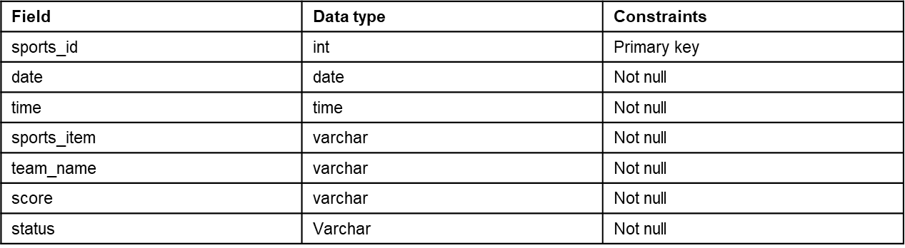
Sports details

Slide 24
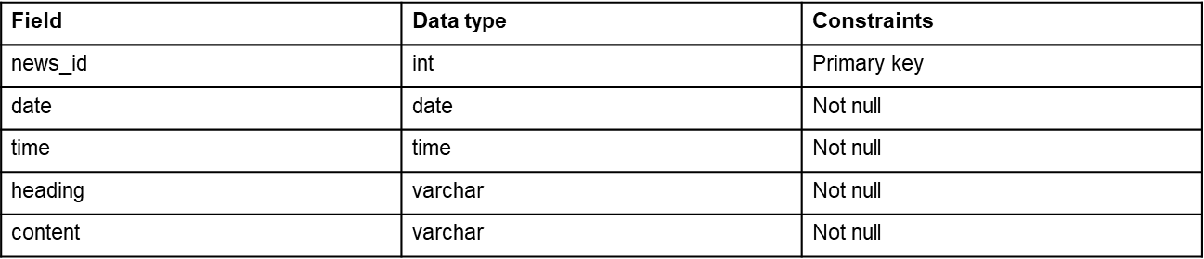
Sports news

Slide 25
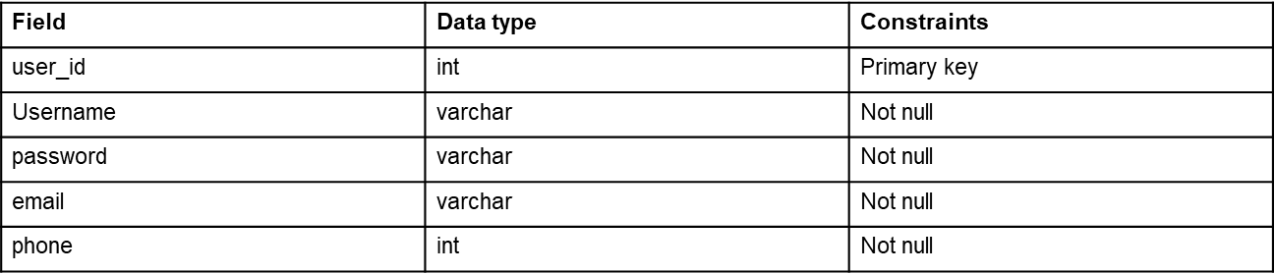
User

Slide 26
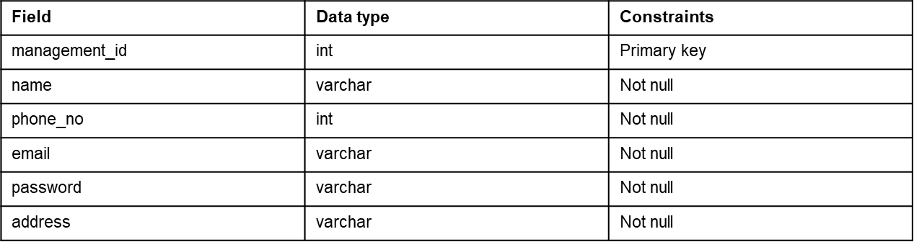
Management

Slide 27
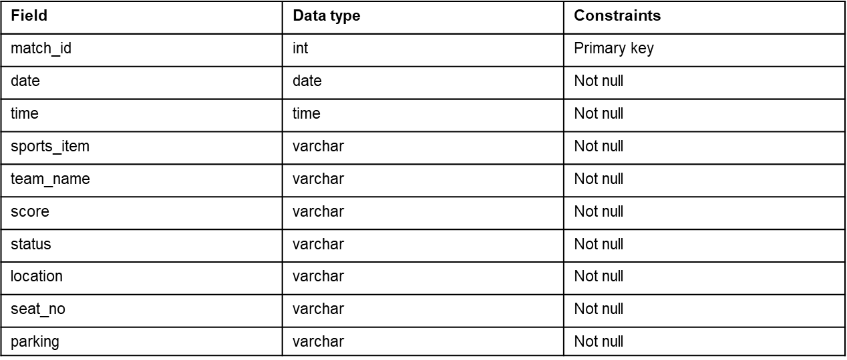
Local match details and facilities

Slide 28
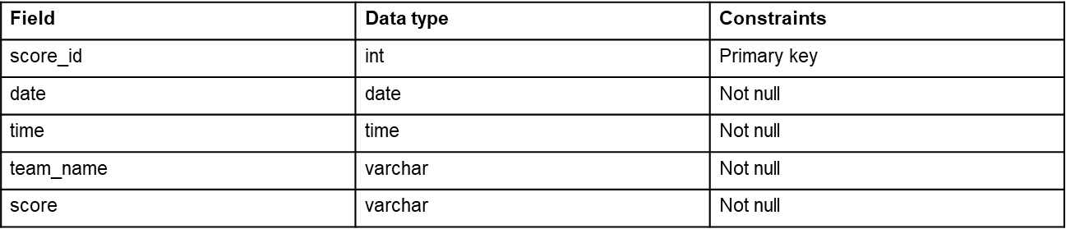
Notification local match score

Slide 29
Forms

Slide 30
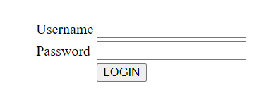
Login

Slide 31
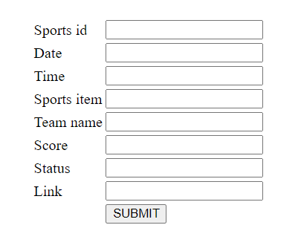
Post sports details

Slide 32
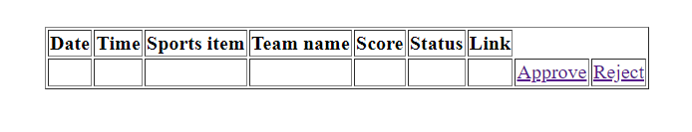
Manage sports details

Slide 33
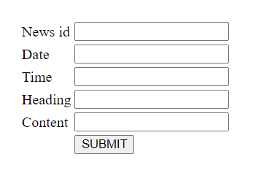
Post sports news

Slide 34
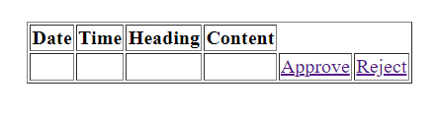
Manage sports news

Slide 35
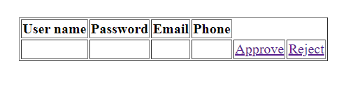
Manage user

Slide 36
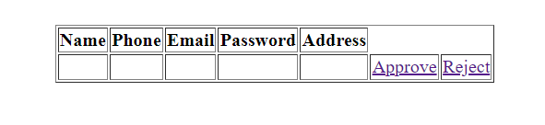
Manage local match managment

Slide 37
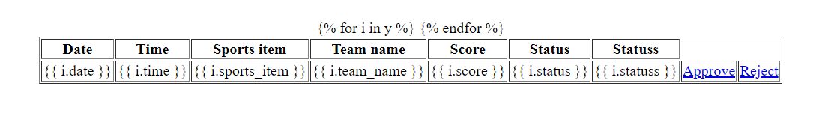
Manage local match details

Slide 38
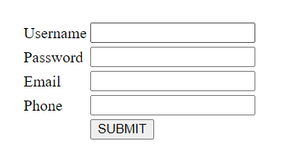
Register (user)

Slide 39
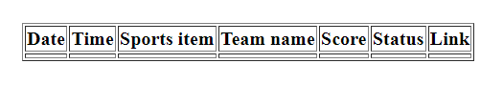
View sports details

Slide 40

View sports news

Slide 41
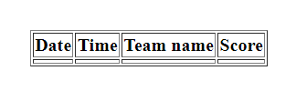
Notification score

Slide 42
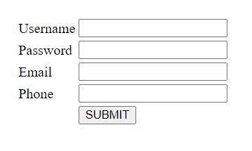
User profile

Slide 43

View facilities

Slide 44
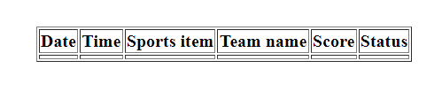
View local match details

Slide 45
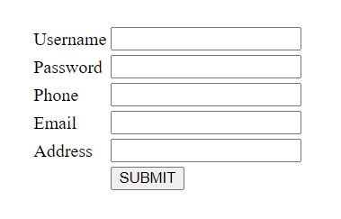
Register (management)

Slide 46
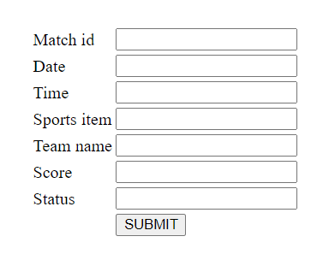
Post local match details

Slide 47
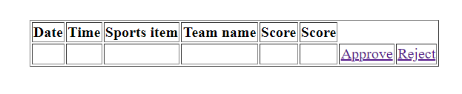
Manage local match details

Slide 48
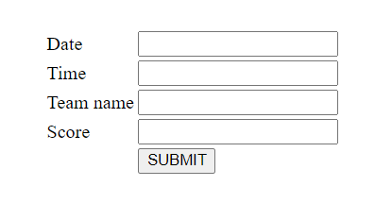
Post notification score

Slide 49


